Slide 1
MSc AI for marketing strategy
Project Management seminar
Session #4
Robert Fonteijn

Slide 2

Activity
Explore « Products » (work management and sales crm) and « Teams ».
Note down the things you found interesting / useful for debate in class.
20’

Slide 3
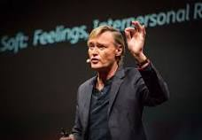
Let’s watch
As work gets more complex 6 rules to simplify | Yves Morieux | TED@BCG
https://www.ted.com/talks/yves_morieux_as_work_gets_more_complex_6_rules_to_simplify
Make notes of the main points that interested you and formulate questions you have.

Slide 4
Change Management : a 4-phase approach
Phase I: Define the Change Mgt Strategy
Phase II: How people experience change
Phase III: Develop the Change Management Plans
Phase IV: Implement, Track & Manage Progress
Company’s strategy
Required change to implement the strategy
Business roadmap
Company readiness for change
Structure and size of change mgt team
Roles & responsibilities
Guiding principles
Change Lean Canvas
Change impact assessment
Objectives and levers (ADKAR Model)
Change Commitment Curve
Change Personal Transition Curve
Heart & Mind Human Drivers
Innovation Adoption Curve
Maslow Hierarchy of Human Needs
Four Stages of Team Development
Stakeholder analysis
Overarching change management plan
Communication plan
Sponsorship plan
Coaching plan
Training plan
Resistance management plan
Governance
Overarching change management plan status report
Communication plan status report
Sponsorship plan status report
Coaching plan status report
Training plan status report
Resistance management plan status report
Change reinforcement

Slide 5
The key question is this:
How are we going to manage:
Changes during the project lifecycle
The changes (or impact) that the project is going to have on its external environment
Remember: a project is an effort to change something

Slide 6
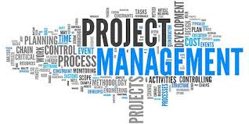
Agenda for Session 4
A few generic change concepts
Teambuilding
A written evaluation

Slide 7
Change management
Projects that aim for change in whatever environment (and most do) are always difficult and often fail.
Six main messages:
Distinguish between different types of change.
Create dissatisfaction.
Create buy-in.
Deal with resistance to change depending on its cause.
Manage the change curve.

Slide 8
Message #1: Different types of change
Changing.....
Incremental
Less difficult
Projects
Processes
Structures
Strategy
Goals
Culture
Transformational
Most difficult

Slide 9
Message #2: Create dissatisfaction
C : (ABD)>X
Where:
C
= change
A
= level of dissatisfaction with the status quo
B
= clarity of the desired state
D
= practical first steps towards the desired state
X
= cost of the change

Slide 10
Message #3 : create buy-in
Make sure that you are clear about the benefits that will arise from the change for each of the stakeholders.
This is where you need the completed stakeholder analysis.
Make sure you create buy-in for each key individual - before you present to groups.

Slide 11
Message #4 : deal with sources of resistance
Re-frame
Persuade
Negotiate
Confront
Sanction
3.
Unwilling
Train
Support
2.
Unable
1.
Unknowing
Talk

Slide 12
Message #5 : the typical change curve
4. Adaptation
1. Denial
Confidence, Moral & Effectiveness
2. Resistance
3. Acceptance, Exploration
Time
Question: what can you usefully do during each of these stages ?

Slide 13
Useful things to do
Denial | Inform
Resistance | Listen
Acceptance | Discuss
Adaptation | Reward

Slide 14
A linked tool : the Change impact assessment matrix
High
The boxes drive the amount of bodies, brains and funds that must be called upon to make things happen.
Complexity of the change
Low
High
PS: both « size » and « complexity » dépend on the stakeholders involved!
Size of the change

Slide 15
The innovation adoption curve
The technology adoption lifecycle is a sociological model that describes the adoption or acceptance of a new product or innovation, according to the demographic and psychological characteristics of defined adopter groups.
The process of adoption over time is typically illustrated as a classical normal distribution or "bell curve".

Slide 16
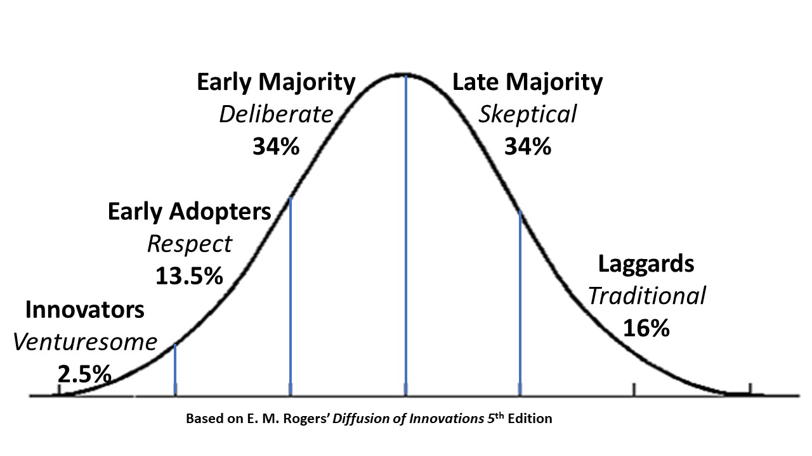

Slide 17
The vocabulary
The categories were originally described in terms of farm practices:
Innovators – had larger farms, were more educated, more prosperous and more risk-oriented
Early adopters – younger, more educated, tended to be community leaders, less prosperous
Early majority – more conservative but open to new ideas, active in community and influencing neighbors
Late majority – older, less educated, fairly conservative and less socially active
Laggards – very conservative, had small farms and capital, oldest and least educated

Slide 18
The Change Canvas : 6 boxes to project-manage change
What will we do to prepare impacted stakeholders ?
Describe the change
What is the vision ?
Who will be impacted ?
What are the business outcomes we are aiming for?
What are the first steps we can now start to make ?
How will we measure where we are going ?
When will they be impacted ?

Slide 19
Agenda for Session 4
A few generic change concepts
Teambuilding
A written evaluation

Slide 20
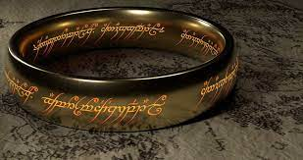


Lord of the Rings movie clip - Project Management
https://www.youtube.com/watch?v=UIVWaUgqEAc

Slide 21
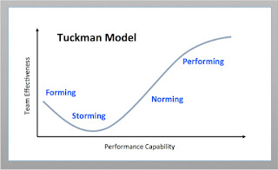
4 stages for creating high-performance teams

Slide 22
Stages 1 and 2: Forming and Storming
Polite
Impersonal
Watchful
Guarded
Concern for structure
Silence
Anxiety
Dependence on leader
Confronting people
Opting out
Sub-grouping
Conflicts
Feeling stuck
Noisy
Rebellion

Slide 23
Norming and Performing
Clearer roles emerging
Developing skills
Establishing procedures and norms
Giving feedback
Confronting issues
More open exchanges
More/better listening
Move to group cohesion
Resourceful – energy focused on the task
Flexible
Openness
Actively seek feedback
Effective
Close and supportive
Settled interdependence

Slide 24
Written evaluation. Individually. One hour.
Create a system of KPIs for your project, linked to the Balanced Scorecard (20’).
List 6 changes that may happen during your project (in terms of schedule, cost or performance), and slot them into the Change Impact Assessment matrix (15’).
Reflect on the team you have been a part of during this seminar: have you become « performing » in some or all of the areas of effectiveness? Explain your thinking (15’). (PS: all answers will stay entirely confidential).
What are the three elements of the A-Z that you found most interesting? Explain your thinking (10’).

Slide 25
Final exam. A report of 4-6 pages. By mail. 17th April latest.
In teams: for each of your projects:
Produce a Risk analysis
Do a Stakeholder analysis
For managing the project, would you prefer agile or waterfall: motivate your choice
Produce a WBS for two pieces of work (Finding sponsors & Programming the bands) .
Produce one Gantt chart integrating these two pieces of work in time.
Explain change management (the Why, What and How) to a fellow student who has not followed this seminar. 1 Page max.

Slide 26

Happy Exams and Successful Easter
For those of you who will decorate the eggs, for those of you who will hide them, find them and eat them.

